Slide 1


Department of Electronics and Communication Engineering
VLSI Design
COURSE CODE
Topic:
NMOS Fabrication process
Session - 3

Slide 2



AIM OF THE SESSION
To familiarize students with Fabrication Process and Their Various Steps.
INSTRUCTIONAL OBJECTIVES
This Session is designed to:
Discuss the Fabrication Process of NMOS Transistor.
Describe the various steps of NMOS Fabrication steps..
LEARNING OUTCOMES
At the end of this session, you should be able to:
Discuss Fabrication Process of MOS Technology.
Discuss Step wise Fabrication process of NMOS..
Summarize the all steps of NMOS Fabrication.

Slide 3
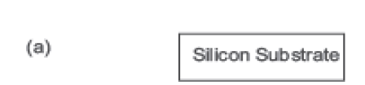
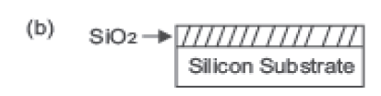
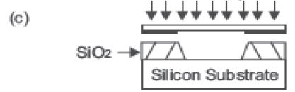
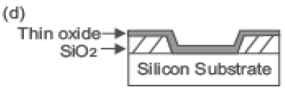
NMOS Fabrication Process
The following description explains the basic steps used in the process of fabrication. (Only for Silicon Substrate)
(a) The fabrication process starts with the oxidation of the silicon substrate. It is shown in the Figure 1.9 (a).
(b) A relatively thick silicon dioxide layer, also called field oxide, is created on the surface of the substrate.
This is shown in the Figure 1.9 (b).
(c) Then, the field oxide is selectively etched to expose the silicon surface on which the MOS transistor will be created. This is indicated in the Figure 1.9 (c).
(d) This is followed by covering the surface of substrate with a thin, high-quality oxide layer, which will eventually form the gate oxide of the MOS transistor as illustrated in Figure 1.9 (d).

Slide 4
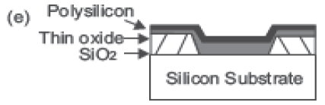
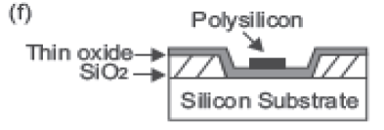
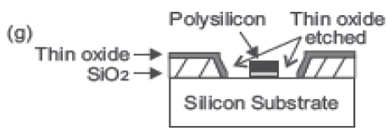
NMOS Fabrication Process (Continue..)
The following description explains the basic steps used in the process of fabrication.
(e) On top of the thin oxide, a layer of polysilicon (polycrystalline silicon) is deposited as is shown in the Figure 1.9 (e).
Polysilicon is used both as gate electrode material for MOS transistors and also as an interconnect medium in silicon integrated circuits.
Undoped polysilicon has relatively high resistivity. The resistivity of polysilicon can be reduced, however, by doping it with impurity atoms.
(f) After deposition, the polysilicon layer is patterned and etched to form the interconnects and the MOS transistor gates.
This is shown in Figure 1.9 (f).
(g) The thin gate oxide not covered by polysilicon is also etched along, which exposes the bare silicon surface on which the source and drain junctions are to be formed (Figure 1.9 (g)).

Slide 5
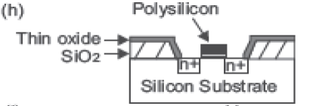
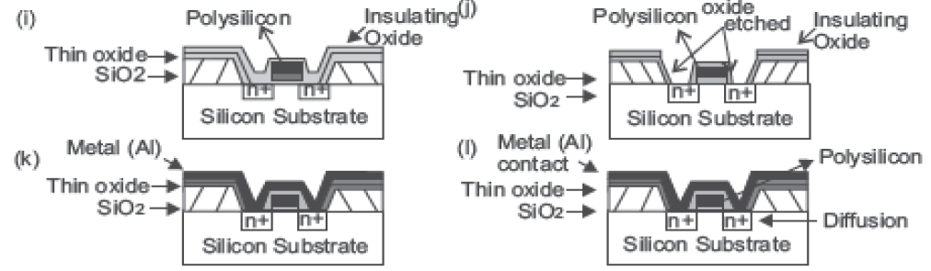
NMOS Fabrication Process (Continue..)
(h) The entire silicon surface is then doped with high concentration of impurities, either through diffusion or ion implantation (in this case with donor atoms to produce n-type doping).
Diffusion is achieved by heating the wafer to a high temperature and passing the gas containing desired impurities over the surface.
Figure 1.9 (h) shows that the doping penetrates the exposed areas on the silicon surface,
ultimately creating two n-type regions (source and drain junctions) in the p-type substrate.
The impurity doping also penetrates the polysilicon on the surface, reducing its resistivity.
(i) Once the source and drain regions are completed, the entire surface is again covered with an insulating layer of silicon dioxide, as shown in Figure 1.9 (i).
(j) The insulating oxide layer is then patterned in order to provide contact windows for the drain and source junctions, as illustrated in Figure 1.9 (j).

Slide 6
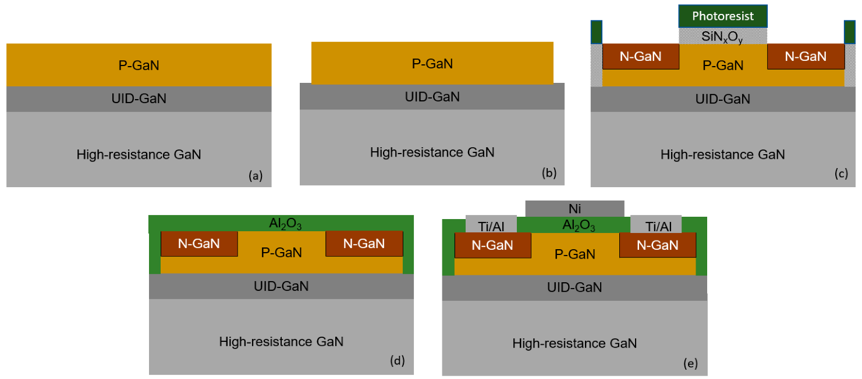
NMOS Fabrication Process (On GaN Substrate)
The fabrication of the GaN-MOSFET structure with the implantation technique starts with the 500 nm-thick homoepitaxial Mg-doped p-GaN (2 × 10¹⁷ cm⁻³) layer grown by MOCVD on a free standing GaN substrate consisting of a thin unintentionally doped GaN (UID- GaN) and high-resistance insulation GaN substrate, as shown in Figure 1.9 (a).
The SiO₂ hard mask is deposited on the top of the free standing GaN structure using the plasma enhanced chemical vapor deposition (PECVD) with tetraethyl orthosilicate and oxygen. Subsequently, mesa structures are defined using the conventional lithography and wet etching of the SiO₂ hard mask. The GaN mesa-insulation regions are formed using Cl₂/BCl₃ reactive-ion etching, as shown in Figure 1.9 (b).
The SiO₂ hard mask is removed using the buffered hydrofluoric (BHF) acid. Subsequently, the source and drain (S/D) regions are implanted with Si atoms at room temperature with 10 nm-thick SiO_{x}N_{y} and photoresist protection layer on the gate regions, as shown in Figure 1.9 (c).
Figure 1.9: Fabrication process of the gallium nitride-metal-oxide field-effect transistors (GaN-MOSFETs) fabricated using the implantation technique. (a) p-GaN grown on a free standing GaN substrate, (b) mesa structure, (c) implantation of Si atoms, (d) Al₂O₃ deposition, (e) contact deposition and annealing.

Slide 7
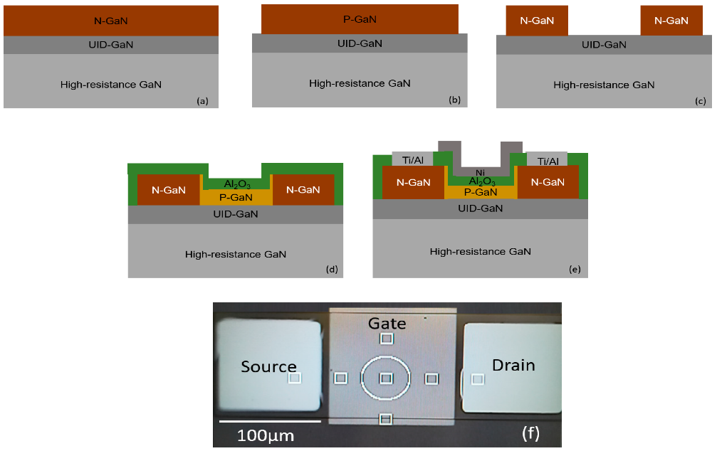
NMOS Fabrication Process (On GaN Substrate) (Conti…)
The implantation energy is 15 keV and the dose implantation is 10¹⁵ cm⁻². The rapid thermal annealing (RTA) in the N₂ atmosphere at 1000 °C is used to activate the dopants after the implantation. For the GaN-MOSFET structure fabricated by the regrowth method, the fabrication process is based on the n-GaN (3 × 10¹⁸ cm⁻³), as shown in Figure 1.10 (a).
The GaN mesa-insulation regions and n-GaN layer on the gate-body region are etched using the reactive-ion etching with Cl₂/BCl₃ gas mixture, as shown in Figure 1.10 (b) and (c). The sample is immerged in the tetramethyl ammonium hydroxide (TMAH) with 10 wt% at 70 °C in 5 min to etch the damaged n-GaN on the vertical side because of the reactive-ion etching. Subsequently, 200 nm-thick Mg-doped p-GaN (2 × 10¹⁷ cm⁻³) is selectively regrown on the gate region. The regrown p-GaN layer is formed using trimethylgallium (TMGa), bis (cyclopentadienyl) magnesium (Cp₂Mg), and NH₃ as precursors at 950 °C.
Figure 1.10: Fabrication process of the gallium nitride-metal-oxide field-effect transistors (GaN-MOSFETs) fabricated using the regrowth method. (a) n-GaN grown on a free standing GaN substrate, (b) mesa structure, (c) etching n-GaN layer on the gate-body region, (d) regrowth of p-GaN and Al₂O₃ deposition, (e) contact deposition and annealing, (f) the top view of the fabricated MOSFETs

Slide 8

NMOS Fabrication Process (On GaN Substrate) (Conti…)
The growth is performed with the NH₃ flux of 10 slm and TMGa flux of 20 sccm. An ozone oxidation at 300 °C is used to form the sacrificial GaO_{x} of the damaged GaN layer, which is subsequently removed using BHF acid. The treatment of forming and removing the sacrificial GaO_{x} layer is repeated two times and re-cleaned using diluted hydrofluoric (DHF) acid and HCl acid with the concentration of 0.8 M (mole/litter). The 28 nm-thick Al₂O₃ thin film as a dielectric is deposited using PEALD with trimethylaluminum and oxygen plasma, as shown in Figure 1.9 (d) and Figure 1.10.
According to previous studies, the Al₂O₃ thin film transforms from amorphous to crystalline phase at over 800 °C. Therefore, Al₂O₃ dielectric is annealed at 700 °C in a nitrogen (N₂) ambience for 1 minute using the rapid temperature annealing (RTA) technique. The electron beam evaporation and conventional wet etching methods are used to form the Ni gate electrodes. The Ti/Al stack structure is formed on the S/D regions by the lift-off technique and subsequently treated with the metallization annealing (PMA) at 600 °C in a N₂ ambience to obtain the ohmic contact, as shown in Figure 1.9 (e) and Figure 1.10 (e). The top view of the fabricated MOSFETs is shown in Figure 1.10 (f).
Figure 1.10: Fabrication process of the gallium nitride-metal-oxide field-effect transistors (GaN-MOSFETs) fabricated using the regrowth method. (a) n-GaN grown on a free standing GaN substrate, (b) mesa structure, (c) etching n-GaN layer on the gate-body region, (d) regrowth of p-GaN and Al₂O₃ deposition, (e) contact deposition and annealing, (f) the top view of the fabricated MOSFETs

Slide 9

EXAMPLES of Fab Lab for Process Engineering

Slide 10
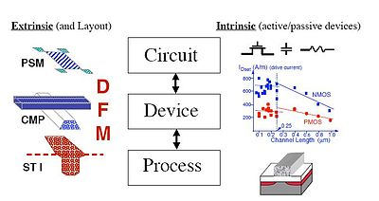
SUMMARY
nMOS Process Engineering dived in various steps: 1. Substrate Selection, 2. Well Diffusion 3. Oxide Layer Deposition, 4. Metal Deposition (Electrode Formation).
There are different substrate for device fabrication. Every substrate has their own pros and cons. Such as Silicon substrate and GaN Substrate.
Hierarchy of technology CAD tools building from the process level to circuits. Left side icons show typical manufacturing issues; right side icons reflect MOS scaling results based on TCAD

Slide 11
SELF-ASSESSMENT QUESTIONS
1. What is main aspect fabrication design.
Device Design
Parameter simulation
Substrate Selection
All of Above
What is the effect of high K Oxide on Device Fabrication.
On Oxide thickness
Channel Length.
Well Diffusion
All Above

Slide 12
TERMINAL QUESTIONS
1. Describe the various step of nMOS fabrication process.
2. Discuss the importance of substrate selection in Process Engineering.

Slide 13
REFERENCES FOR FURTHER LEARNING OF THE SESSION
Reference Books:
1. Sung-Mo Kong, Yusuf Leblebici, “CMOS Digital Integrated Circuits Analysis and Design” Third Edition.
2. Debaprasad Das, “CMOS DESIGN” Second Edition.

Slide 14
THANK YOU
Team – VLSI DESIGN

